Slide 1
School Meal Programs
Provided by the LAUSD Food Services Division
Notes:
Read: Hello and welcome to the Meal patterns and Offer Versus Serve training for the LAUSD Food Services Division.

Slide 2
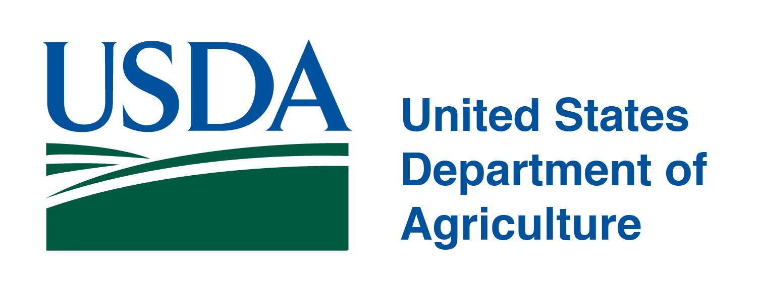
Overview
Federal meal programs are highly regulated and designed to provide children with nutritionally balanced meals.
The program generates its own funding by way of reimbursement for meals served to students
Specific guidelines for every aspect of the program and compliance is mandatory
Audits are done routinely by the State to ensure that Districts are maintaining the integrity of the program

Slide 3
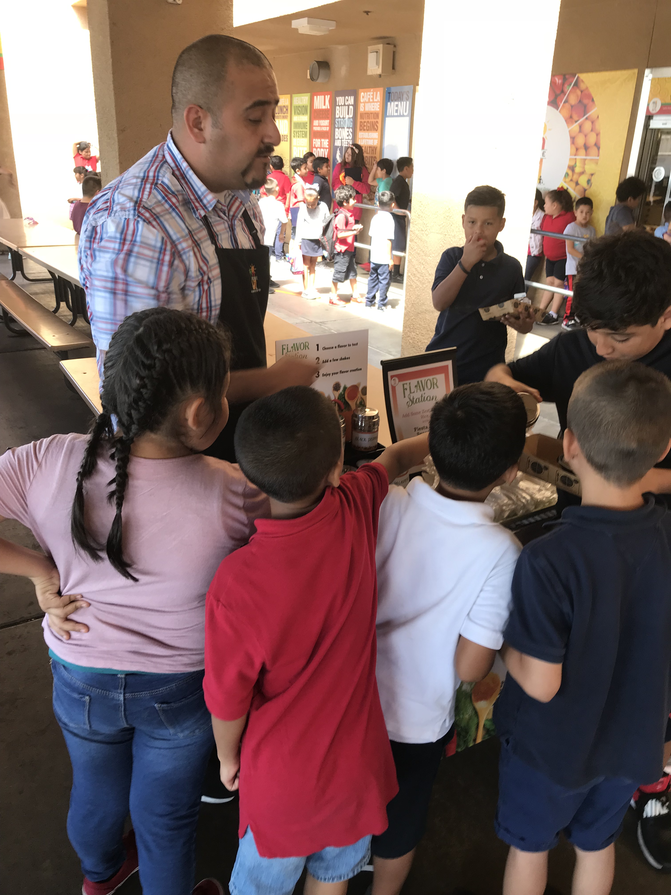
National School Lunch Act
Since Harry S. Truman signed the National School Lunch Act into law in 1946 the federal government has been subsidizing School Nutrition Programs across the country.
The purpose is provide students nutritionally balanced meals to “safeguard the health and well-being of the Nation's children and to encourage the domestic consumption of nutritious agricultural commodities and other foods.”

Slide 4
Healthy, Hunger Free Kids Act of 2010:
The HHFKA authorizes funding for federal school meal and child nutrition programs and increases access to healthy food for low-income children.
Instructs the USDA to establish standards consistent with the most recent Dietary Guidelines for Americans
Strengthens school food nutrition standards for all foods regularly sold in schools during the school day
Ex: vending machines, a la carte sales, student stores
Builds on the USDA’s work to improve the nutritional quality of commodity foods
Notes:
TELL:
Recent legislation provides improvements to help children access healthier, more nutritious food options to help combat obesity. A combination of several initiatives led to the improvements seen in school meals.
(3) Let’s Move was launched by First Lady Michelle Obama in 2010. The goal of this initiative is to solve childhood obesity within a generation so that children born today will reach adulthood at a healthy weight. It encourages:
Healthier food in schools
Better food labeling, and
More physical activity for children.
Healthy, Hunger Free Kids Act of 2010 –Signed by President Obama in February 2010, this initiative updated school meal nutrition standards to reflect the most current 2010 Dietary Guidelines for Americans.
So, all of these initiatives have been brought together to promote healthier eating among Americans and to
improve school meal programs.

Slide 5
State Level School Meal Mandates
California requires all public schools must provide at least one nutritious meal to all free or reduced priced meal eligible students.
The law also requires that severe-need schools have a breakfast program for providing breakfast to low-income children
LAUSD meets and exceeds these requirements by providing students:
Breakfast, Lunch, Supper or Snack
Notes:
TELL: California requires that all public schools must provide at least one nutritious meal that meets federal standards to all free or reduced priced meal eligible students on a daily basis while school is in session. The law also requires that severe-need schools have a breakfast program to provide breakfast to low-income children.

Slide 6
Universal Meals
California will become the first state to implement a statewide Universal Meals Program for all school children. California’s Universal Meals Program is designed to build on the foundations of the federal National School Lunch Program (NSLP) and School Breakfast Program (SBP).
Students will be categorized by meal eligibilities
Reduced and Full-Price students will eat at no charge
No co-pay will be collected
Notes:
TELL: California requires that all public schools must provide at least one nutritious meal that meets federal standards to all free or reduced priced meal eligible students on a daily basis while school is in session. The law also requires that severe-need schools have a breakfast program to provide breakfast to low-income children.

Slide 7
School Nutrition Programs
Child And Adult Care Food Program (CACFP)
Supper Program
National School Lunch Program (NSLP)
Summer Food Service Program (SFSP)
Early Education Centers
Seamless Summer Option (SSO)
School Breakfast Program (SBP)

Slide 8
School Breakfast Program
The School Breakfast Program (SBP) provides federally subsidized breakfast to children at schools and childcare facilities in the U.S.
SBP is a subset of the National School Lunch Act
Must meet nutritional standards set by the United States Department Agriculture (USDA)
Notes:
TELL: The School Breakfast Program provides per meal cash reimbursements to public and nonprofit private schools and residential childcare institutions that provide free and reduced-price breakfasts to eligible children. The program is administered at the federal level by the U.S. Department of Agriculture, which provides funding for the program, and at the state level by either the state department of education or agriculture. The SBP is a subset of the National School Lunch Act. All meals served must meet the nutritional standards set by the USDA. Lets’ take a look at these nutritional standards on the next slide.

Slide 9
National School Lunch Program
The National School Lunch Program (NSLP) is a federally assisted meal program operating in public schools, nonprofit private schools, and residential childcare institutions.
Offers free or low-cost lunches to eligible children each school day
Must meet nutritional standards set by the United States Department Agriculture
Non-eligible children may also participate in the program
Early Education Centers
Notes:
TELL: The National School Lunch Program assists with many schools and residential childcare institutions with offering free or lost cost lunches to eligible children and non-eligible children. As long as the schools and childcare institutions meet nutritional standards set by the United State Department Agriculture they can continue in providing affordable lunches to children.

Slide 10
Child Adult Care Food Program
The Child Adult Care Food Program (CACFP) is a federally funded program that provides meal reimbursement for meals served to eligible participants.
At Risk After School Supper Program
Notes:
TELL: The Child and Adult Care Food Program (CACFP) is a federal program administered by the USDA designed to ensure that children in child care in America get the best possible nutrition, to help them 28% less likely to be in fair or poor health and 26% less likely to be hospitalized.

Slide 11
Summer Food Service Program
The Summer Food Service Program (SFSP) is a federally funded, state administered program.
SFSP reimburses providers who serve healthy meals during the summer months at no charge.
Children 18 years and under
Low-income areas
Notes:
TELL: FSD continues to serve food during the summer break with the Summer Food Service Program (SFSP). The SFSP is a federally-funded, state administered program.
SFSP reimburses providers who serve healthy meals during the summer months at no charge. Meals may be served at approved sites in low income areas, and children 18 years and under may participate in the meal program.

Slide 12
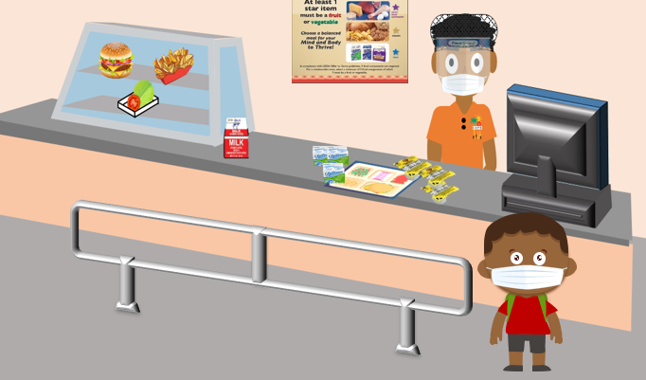
Seamless Summer Option
The Seamless Summer Option (SSO) is a federal and state funded program that encourages school food authorities (SFA) participating in the National School Lunch Program (NSLP) or School Breakfast Program (SBP) to provide meals in low-income areas during the summer. SSO combines features of the NSLP, SBP, and Summer Food Service Program.
Current waivers extend SSO through the 2021-2022 school year.
Notes:
TELL: FSD continues to serve food during the summer break with the Summer Food Service Program (SFSP). The SFSP is a federally-funded, state administered program.
SFSP reimburses providers who serve healthy meals during the summer months at no charge. Meals may be served at approved sites in low income areas, and children 18 years and under may participate in the meal program.

Slide 13
Governmental Initiatives
Dietary Guidelines for Americans 2010:
Focuses on balancing calories with physical activity
Encourages Americans to consume more healthy foods
MyPlate is a tool designed to:
Support the Dietary Guidelines for Americans
Promote healthy eating
Use the 5 food groups arranged like a place setting to make choosing a healthy diet easier
Notes:
TELL:
Recent legislation provides improvements to help children access healthier, more nutritious food options to help combat obesity. A combination of several initiatives led to the improvements seen in school meals.
The new Dietary Guidelines for Americans 2010 focuses on balancing calories with physical activity and encourages Americans to consume more healthy foods.
(2) MyPlate replaced the Food Guide Pyramid. It is a simple, easy to understand tool designed to support the Dietary Guidelines for Americans. It illustrates the 5 food groups that build a healthy diet using a familiar image – a place setting for a meal.

Slide 14
Governmental Layers of School Nutrition Programs
Secretary of Agriculture
FNS
CDE/CDSS
SFA
USDA
The United States Secretary of Agriculture is the head of the U.S. Department of Agriculture.
Notes:
TELL: Here is the breakdown of the hierarchy of the School Nutrition Programs. The US Secretary of Agriculture is the head of the United States Department of Agriculture.

Slide 15
Governmental Layers of School Nutrition Programs
Secretary of Agriculture
FNS
CDE/CDSS
SFA
USDA
The United States Department of Agriculture is responsible for developing and executing federal government policy on farming, agriculture, forestry, and food.
Notes:
TELL: On the next level, the United States Department of Agriculture is responsible for developing and executing federal government policy on farming, agriculture, forestry, and food.

Slide 16
Governmental Layers of School Nutrition Programs
Secretary of Agriculture
FNS
CDE/CDSS
SFA
USDA
The Food and Nutrition Service, is an agency of the USDA and is the federal agency responsible for administering the nation’s domestic nutrition assistance programs.
Notes:
TELL: Next, the Food and Nutrition Service is an agency of the USDA and is the federal agency responsible for administering the nation’s domestic nutrition assistance programs.

Slide 17
Governmental Layers of School Nutrition Programs
Secretary of Agriculture
FNS
CDE/CDSS
SFA
USDA
The California Department of Education and the California Department of Social Services are agencies within the Government of California that oversees public education and school meal operations.
Notes:
TELL: Below that, the California Department of Education is an agency within the Government of California that oversees public education and school meal operations.

Slide 18
Governmental Layers of School Nutrition Programs
Secretary of Agriculture
FNS
CDE/CDSS
SFA
USDA
A School Food Authority (SFA) is the administering unit for the operation of a school feeding program. SFAs receive federal meal reimbursements for meal programs and are responsible for ensuring that meal counts and eligibility criteria are met.
Notes:
TELL: Finally, a School Food Authority (SFA) is the administering unit for the operation of a school feeding program. SFAs receive federal meal reimbursements for meal programs and is responsible for ensuring that meal counts and eligibility criteria are met.

Slide 19
Program Administrators
USDA provides cash subsidies and USDA foods for each reimbursable lunch served under NSLP, CACFP & SSO. School Food Authorities (SFA) must serve meals that meet Federal meal pattern requirements.
The school meal programs are administered by State agencies, which operate the programs through agreements with School Food Authorities (SFA).
LAUSD Food Services Division must meet all requirements set by the USDA, California Department of Education (CDE) and California Department of Social Services. Compliance with regulations is verified through routine audits.

Slide 20
Meal Reimbursements
Reimbursements are:
Money received for each meal served that meets the Federal meal requirements
Amounts are based on the type of meal served and the student’s eligibility category
A reimbursable meal is:
A school meal meeting the USDA meal requirements and nutrition standards
Served to an eligible student
Priced as an entire meal rather than based on individual items
Notes:
Ask: So, what is reimbursement?
TELL: Reimbursement is the money received for each meal served that meets the Federal meal requirements. The amount of reimbursement received is based on the type of meal served and the student’s eligibility category.

Slide 21
NSLP & SBP Meal Reimbursements
The NSLP and SBP are federally funded at specific rates set by the USDA each year to cover the cost of free and reduced meals, as well as some additional support for paid meals.
SBP and NSLP Reimbursement Rates
Type of Meal
Free
Reduced
Paid
Breakfast
$2.04
$1.74
$0.29
Lunch
$3.18
$2.78
$0.32
Example only, rates are updated annually.
Notes:
TELL: The NSLP and SBP are federally funded at specific rates set by the USDA each year to cover the cost of free and reduced meals, as well as some additional support for paid meals. The purpose of these child nutrition programs is to provide nutritionally balanced, low-cost or free meals to children each school day.

Slide 22
CACFP & SFSP Reimbursements
CACFP and SFSP Reimbursement Rates
CACFP
SFSP
Breakfast
$2.20
$2.375
Lunch
$3.65
$4.15
Supper
$3.65
N/A
Example only, rates are updated annually.

Slide 23
Reimbursement Eligibility
The point of service is when a determination is made that a reimbursable meal has been served to an eligible child.
All meal components must be offered
Must adhere to the hours of service designated by the CDE and CDSS.
Congregate feeding allows children to eat while enjoying the company of friends.
Meals must be consumed on the school site.
Off-site consumption is seldom allowed

Slide 24
Reimbursement Claims
Reimbursements are claimed by School Food Authorities (SFAs) that meet regulations and follow this process:
1. | Serve reimbursable meals and snacks to students
2. | Record the contents of reimbursable meals and snacks on a Production Record
3. | Confirm and record who receives the meals and snacks
4. | Claim meals and snacks by eligibility status of students who receive them
Notes:
TELL: School Nutrition Programs are federally run by the Food and Nutrition Service (FNS), a division of the United States Department of Agriculture. School Nutrition Programs distribute reimbursements to State agencies such as the California Department of Education (CDE). Financial reimbursement is claimed by School Food Authorities (SFAs) that meet regulations by serving reimbursable meals and snacks to students, adequately recording the claims of those meals including: who receives the meals and their eligibility status.

Slide 25
Program Audits
The CDE audits the SFA’s meal programs at regular intervals. Failure to comply with guidelines can lead to fiscal sanctions.
Program | Audit Frequency
NSLP/SBP/SSO | Between 3-5 years (Determined by CDE)
CACFP | Every 2 years
SFSP | Every 2 years
Notes:
TELL: AFSS are to conduct the EEC monitoring’s which are required to be completed 3 times per year, all are unannounced, and completed by the scheduled due dates. The 1st Monitoring must be completed before October/November 2019. The 2nd Monitoring must be completed before February/March 2020. The 3rd Monitoring must complete before May/June, 2020.
7 CFR 116.16 states sponsoring agencies must conduct reviews of each facility three times in a consecutive 12-month period, with intervals no greater than six months.
Next Slide

Slide 26
Important Facts About The Programs
USDA programs are monitored by the CDE and CDSS.
Programs are highly regulated and it is critical to be in compliance.
Meal Patterns & Nutritional Value
Meal Access & Eligibility Requirements
Resource Management
General Compliance
Other Federal Program Reviews
Non Profit Program
Non-compliance can result in program cancellation and fiscal sanctions.

Slide 27
Thank You!
LAUSD Food Services Division
Nourishing Children to Achieve Excellence
Notes:
TELL: Questions?

